Slide 1



1 0 0 1 0 1 0 1 1 1 0 0 1
1 0 0 1 0 1 0 1 1 1 0 1 1
0 0 1 1 0 1 0 1 1 1 1 0 1
0 1 0 0 0 1 0 1 1 0 0 1 1
1 0 0 1 0 1 0 1 1 1 0 0 1
1 0 0 1 0 1 0 1 1 0 0 0 1
0 0 1 0 0 1 0 1 1 1 1 0 1
1 0 0 1 0 1 0 1 1 1 1 0 1
0 0 1 1 0 1 0 1 0 1 0 1 1
1 1 0 0 0 1 0 0 1 1 1 0 1
1 0 1 1 0 1 0 1 1 0 0 0 1
201839060053
Ryvel T.S.
2018390600xx
Sobuj H.

Slide 2

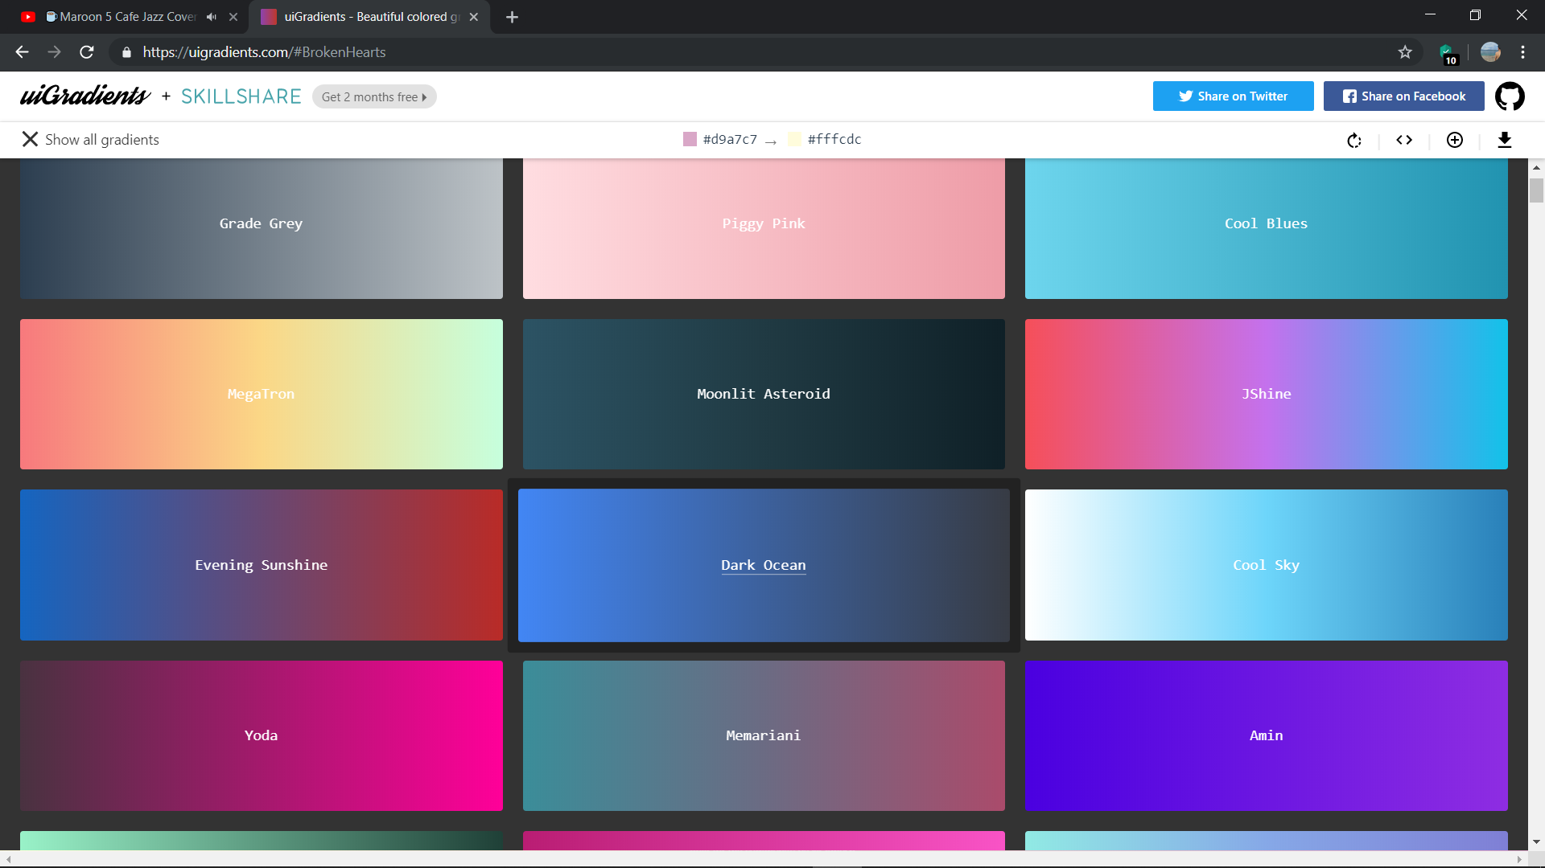
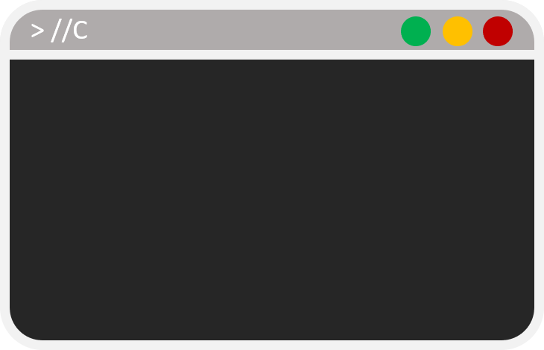
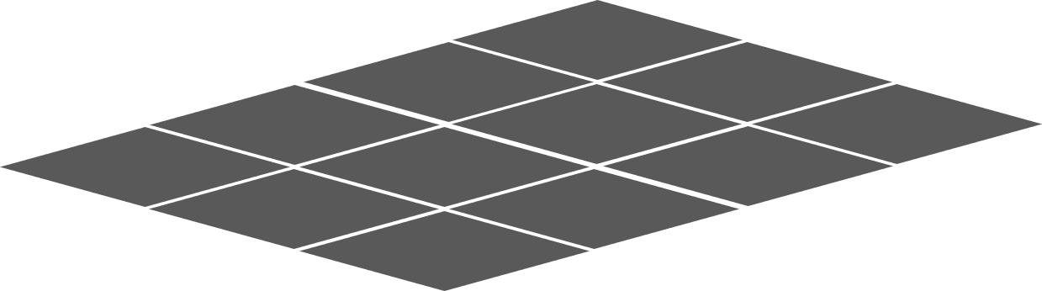
How to Design a Map?
3
4
2
//Use 3D Array
Array[10][24][24]={
{1,1,1,1,1,1,1,1,1,1,1,1,…
1,0,0,0,2,3,4,1,1,0,0,0,….
},
};
1
0
1
0
Use 3D Array
Array[Level][rows][column]
for(int i = 0;i< rows;i++){
for(int j = 0;j< column;j++){
switch(map[level][i][j]){
case ‘0’:
printf(“ “); break;
}}}

Slide 3
A - Move Up
W – Move Down
S – Move Left
D – Move Right
1
4
6
4
W
7
W
for(int i = 0;i< rows;i++){
for(int j = 0;j< column;j++){
If (map[level][i][j]==2|| map[level][i][j]==6)
break;}}
char c;
c= getch;
switch (c){
case ‘w’ : if(…….
break;
A
D
A
S
S
D

Slide 4
What is The Finish Condition?
- When all the boxes have been stored on the target location
int Block_Counter=0;
for(int rows=0;rows<Game_Maps_Rows;rows++){
for(int columns=0;columns<Game_Maps_Column;columns++){
if(Game_Maps[Current_Level][rows][columns] == 3)
Block_Counter++;
}
}
if(Block_Counter==0){
Change_Lvl_Information();
}
}
3
2
4
7
- When, there is no any elements that equal to ‘3’

Slide 5
How good did you finish the level ?
1
2
3
0
Move =
1
0
Push =
case 'w':
case 'W':
case 72:
if(Game_Maps[Current_Level][Rows-1][Columns]==0||Game_Maps[Current_Level][Rows-1][Columns] == 4)
{
Game_Maps[Current_Level][Rows-1][Columns] += 2;
Game_Maps[Current_Level][Rows][Columns] -= 2;
Player_Move++;
}
else if(Game_Maps[Current_Level][Rows-1][Columns]==3||Game_Maps[Current_Level][Rows-1][Columns] == 4||Game_Maps[Current_Level][Rows-1][Columns] == 7)
{
if(Game_Maps[Current_Level][Rows-2][Columns]==0||Game_Maps[Current_Level][Rows-2][Columns] == 4)
{
Game_Maps[Current_Level][Rows-2][Columns] += 3;
Game_Maps[Current_Level][Rows-1][Columns] -= 1;
Game_Maps[Current_Level][Rows][Columns] -= 2;
Player_Move++;
Player_Push++;
}
}
1
W
W
4
4
7
A
S
S
D

Slide 6

Did you Make a Mistake ?
Restart Level
system("cls");
Player_Move=0;
Player_Push=0;
for(int rows=0;rows<Game_Maps_Rows;rows++){
for(int columns=0;columns<Game_Maps_Column;columns++){
Game_Maps[Current_Level][rows][columns] = Recovery_Maps[Current_Level][rows][columns];
}
}
Print_InGame_Maps();
}

